Slide 1
Adaptive Control of a Quadrotor UAV
Aleix Paris i Bordas
MIT AeroAstro

Slide 2
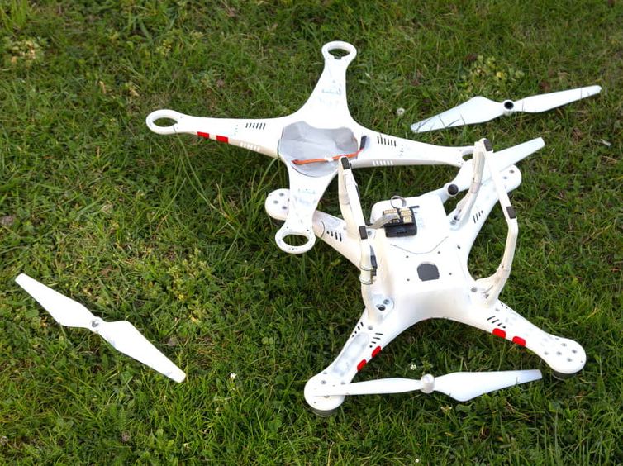
Motivation
Quadrotor helicopters are inherently unstable
Sources of uncertainty:
Actuator degradation
External disturbances
Complex unmodeled dynamics (e.g. blade flapping, asymmetric angular speed of propellers)
This is amplified in the case of actuator failures
Therefore, adaptive control is a useful solution

Slide 3
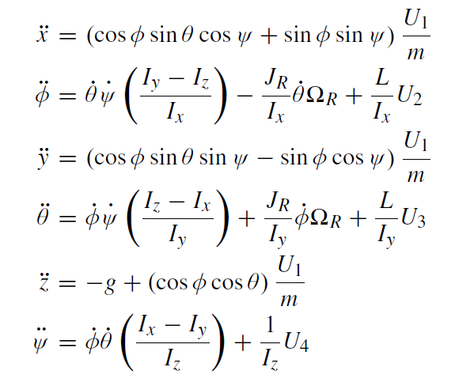
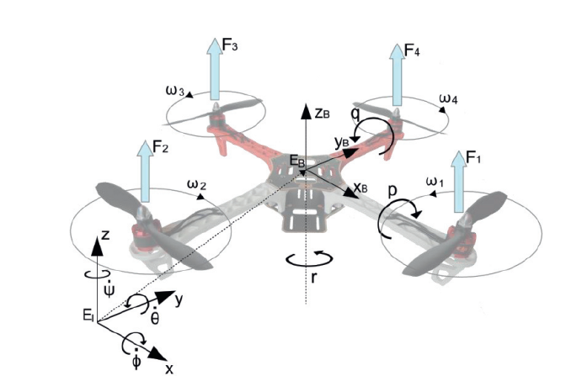
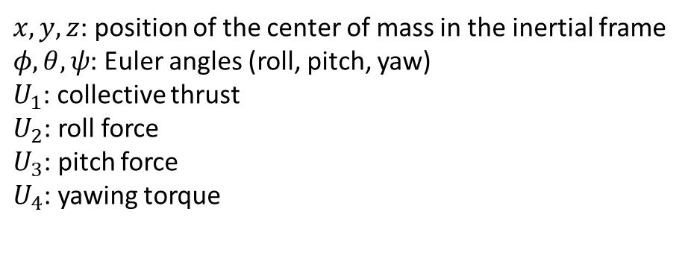
Quadrotor Dynamics
Assuming rigid body and low speeds:
$x,y,z$: position of the center of mass in the inertial frame
$φ,θ,ψ$: Euler angles (roll, pitch, yaw)
$U_{1}$: collective thrust
$U_{2}$: roll force
$U_{3}$: pitch force
$U_{4}$: yawing torque

Slide 4
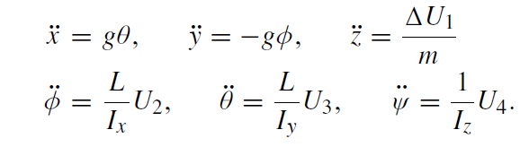
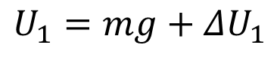
Quadrotor Linear Dynamics
Assuming that the quadrotor is usually close to hover:
$$U_{1}=mg+ΔU_{1}$$
To design our controller, we will use these dynamics

Slide 5
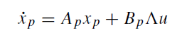
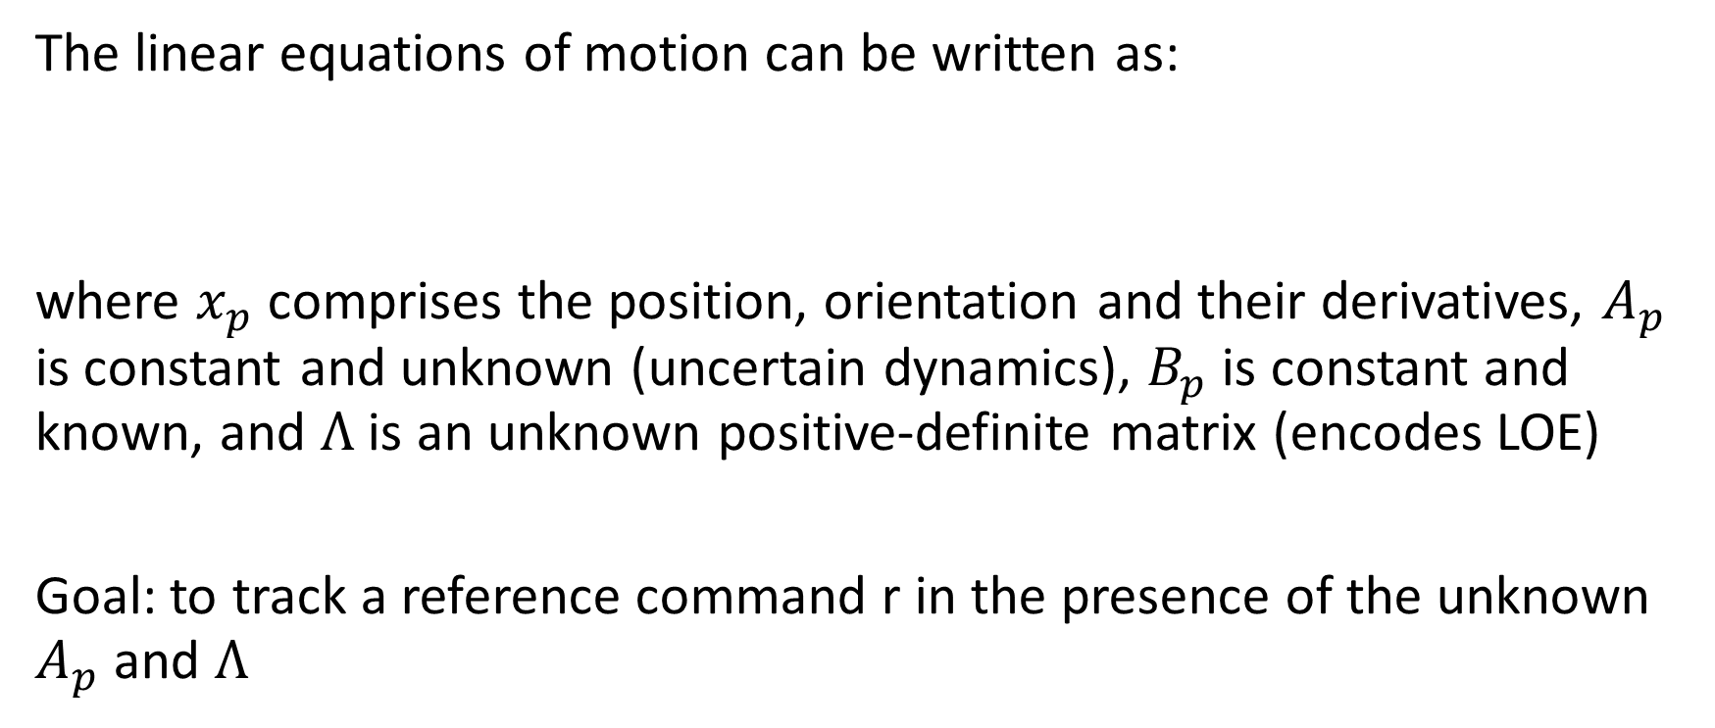
Problem Statement
The linear equations of motion can be written as:
where $x_{p}$ comprises the position, orientation and their derivatives, $A_{p}$ is constant and unknown (uncertain dynamics), $B_{p}$ is constant and known, and $Λ$ is an unknown positive-definite matrix (encodes LOE)
Goal: to track a reference command r in the presence of the unknown $A_{p}$ and $Λ$

Slide 6
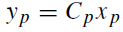
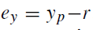
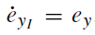
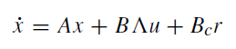
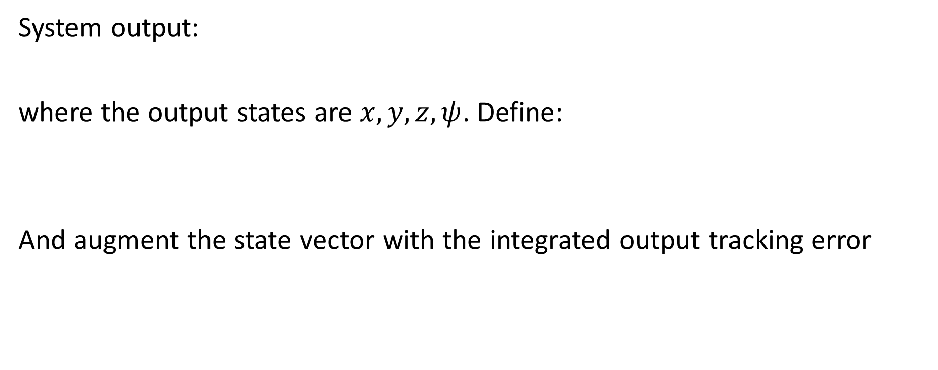
Problem Statement
System output:
where the output states are $x,y,z,ψ$. Define:
And augment the state vector with the integrated output tracking error

Slide 7
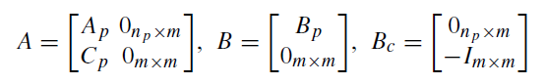
Problem Statement
The extended open-loop system matrices are then:

Slide 8
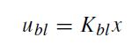
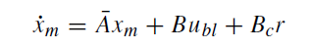
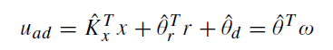
Controller Design
Baseline controller:
Adaptive controller: MRAC approach. The reference model is:
Adaptive control input added to the baseline controller:

Slide 9
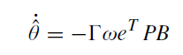
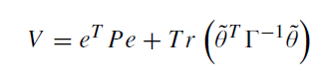
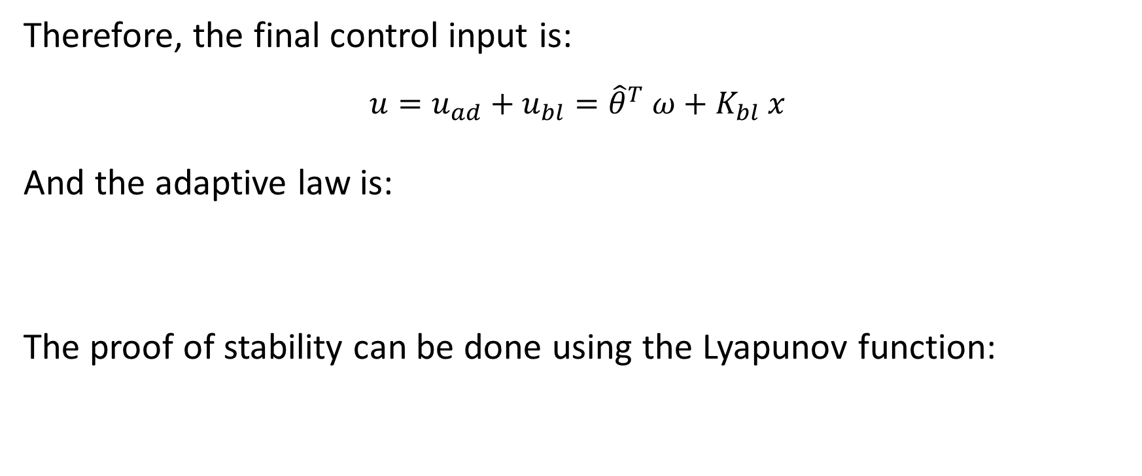
Controller Design
Therefore, the final control input is:
$$u=u_{ad}+u_{bl}={\hat{θ}}^{T} ω+K_{bl} x$$
And the adaptive law is:
The proof of stability can be done using the Lyapunov function:

Slide 10
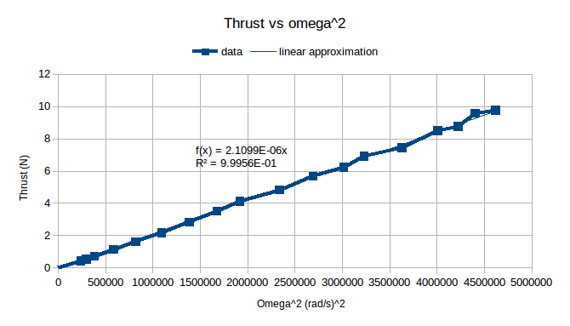
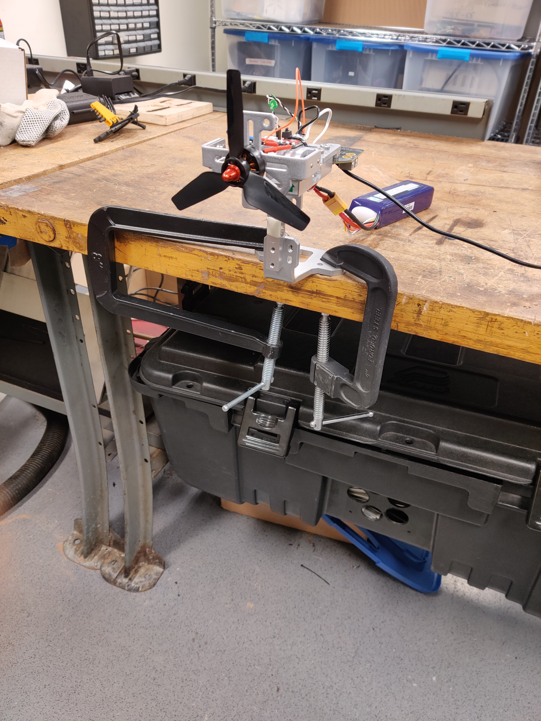
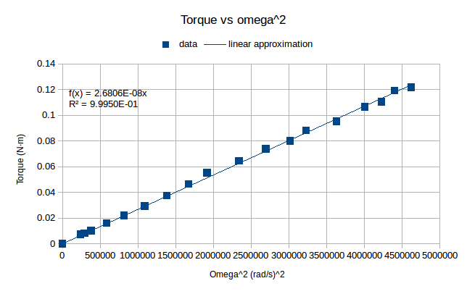
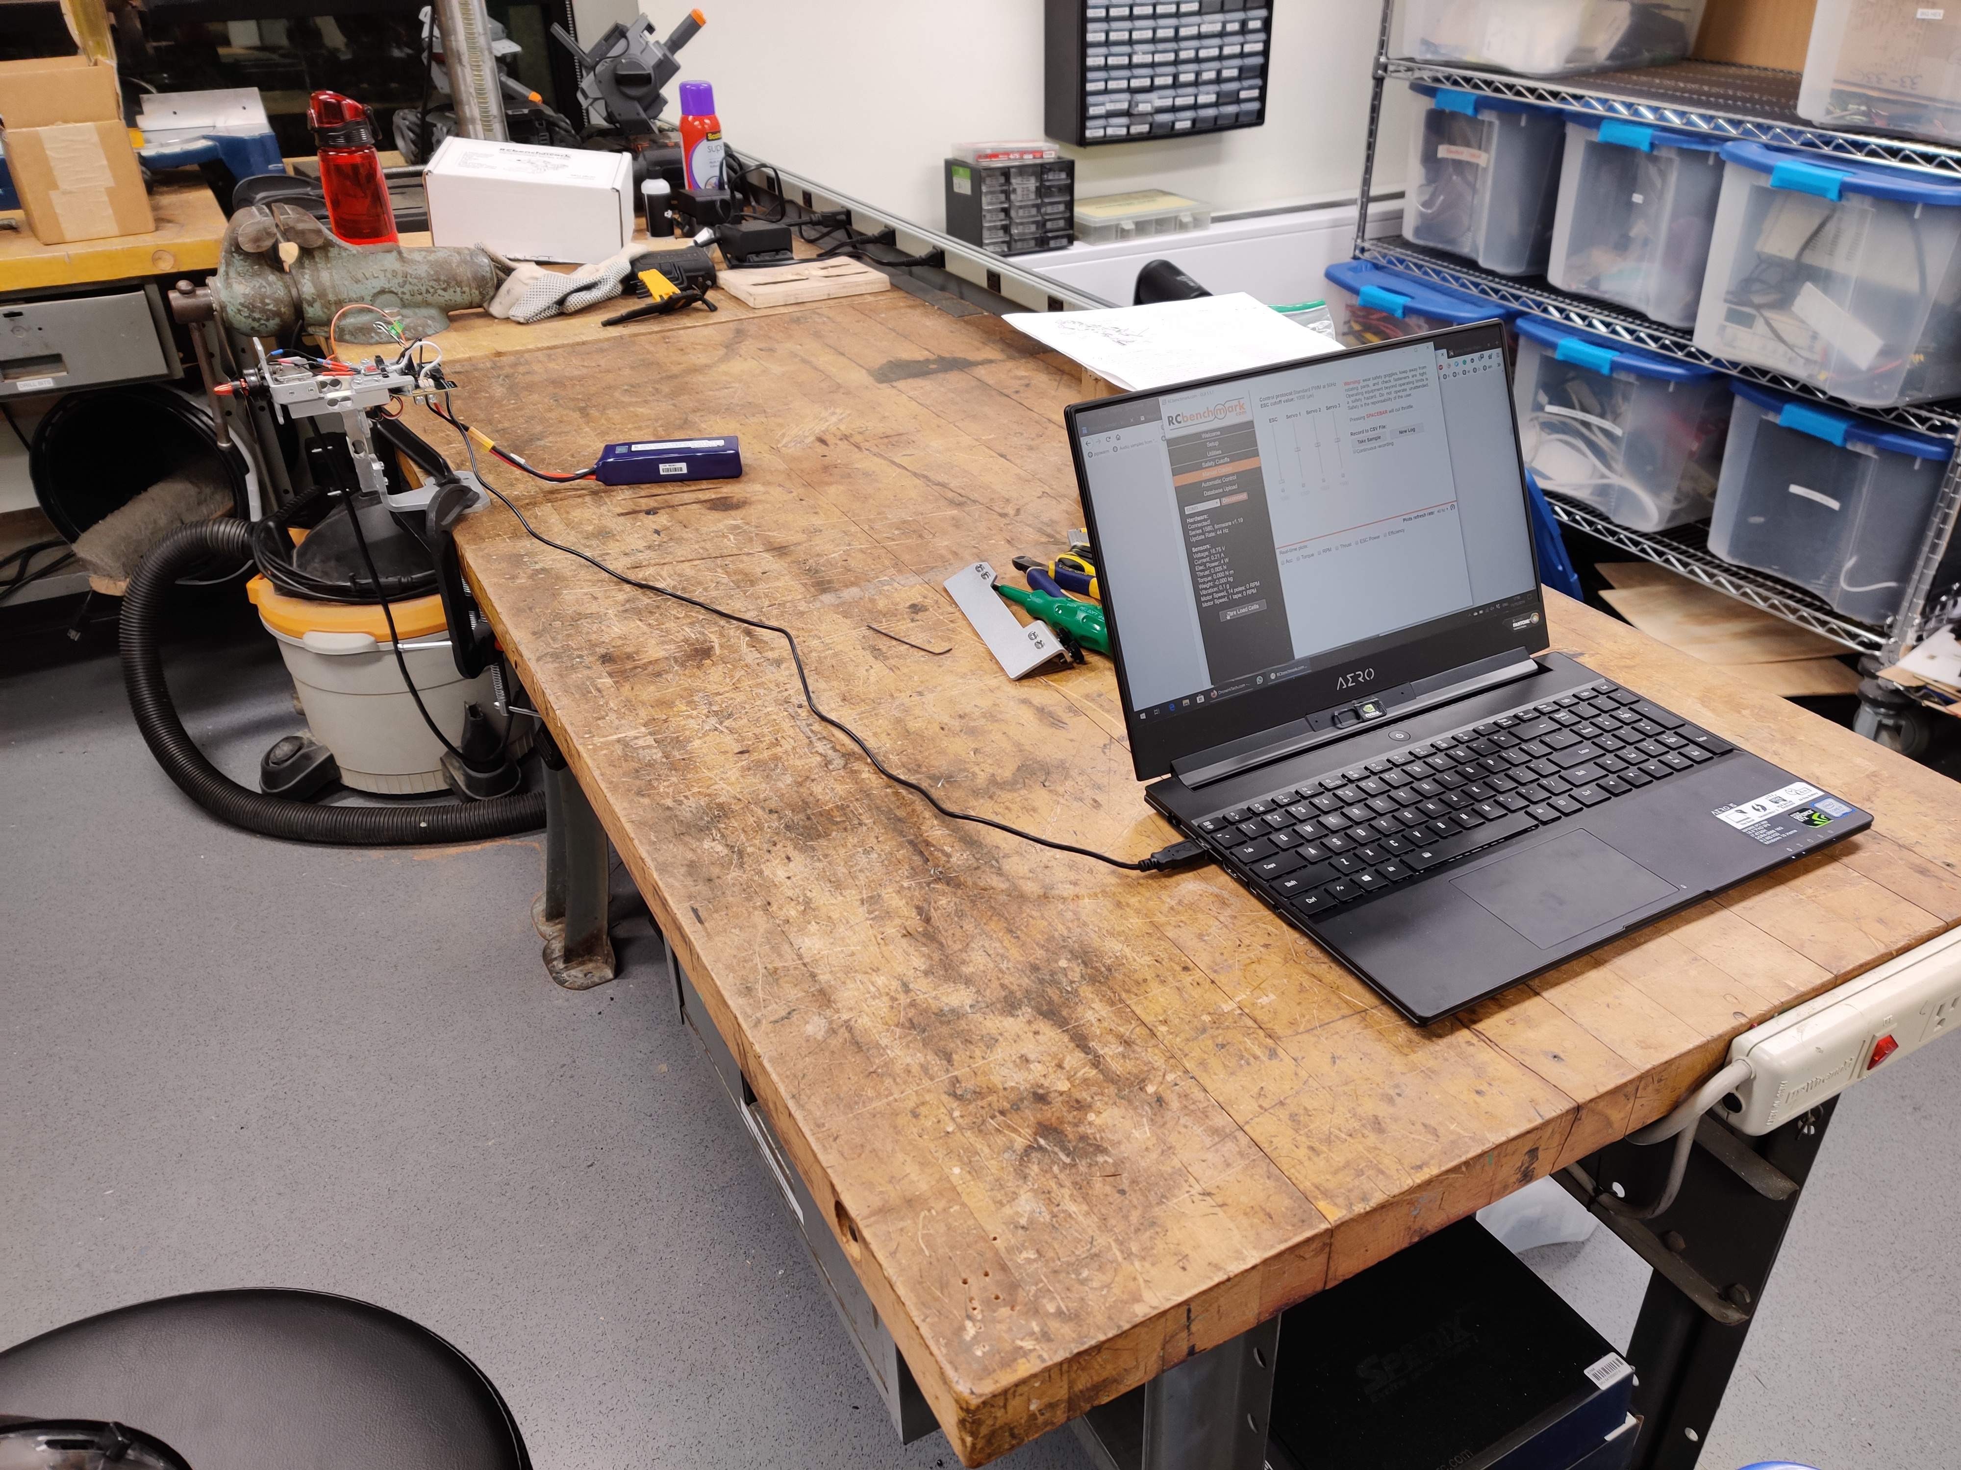
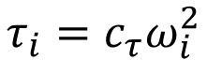
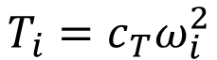
Experimental Data
$$T_{i}=c_{T}ω_{i}^{2}$$
$$τ_{i}=c_{τ}ω_{i}^{2}$$

Slide 11
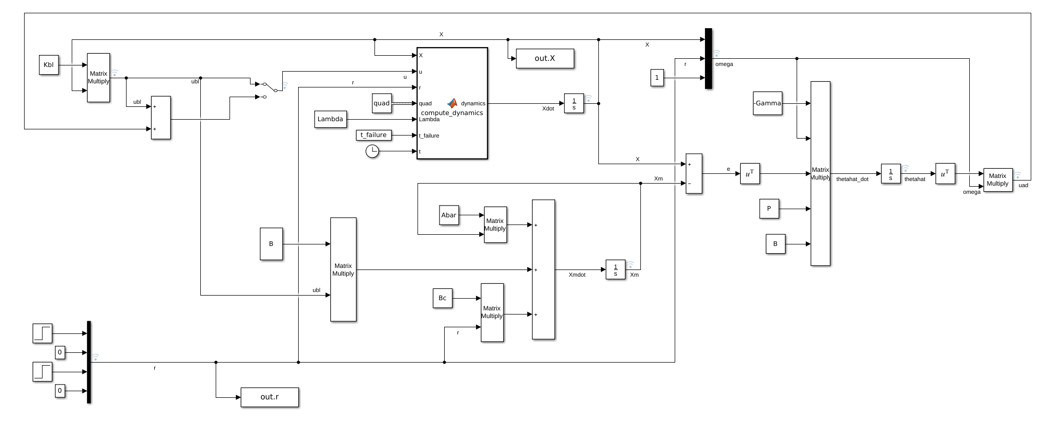
Simulation

Slide 12
Results
In the following results, the drone was commanded to climb to 5 m and move in the x direction 1 m at t = 1 s
At t = 12 s, one of the motors suffers a 60% loss-of-effectiveness failure (LOE)

Slide 13
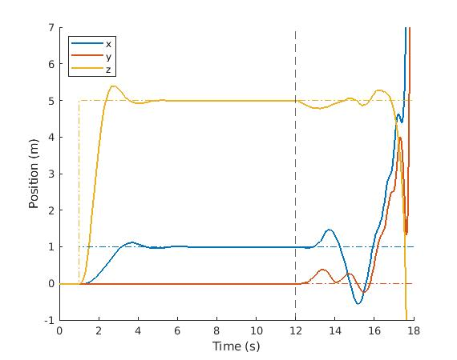
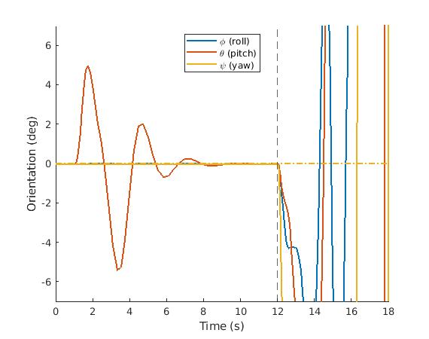
Results – Baseline Controller

Slide 14
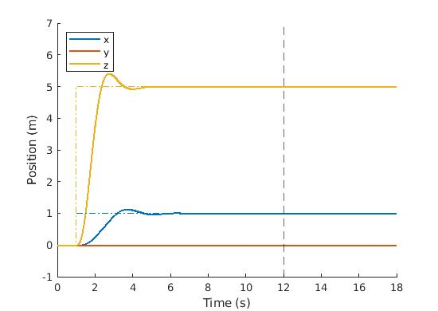
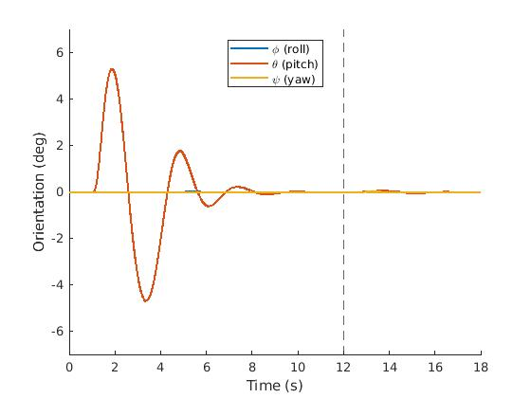
Results – Adaptive Controller

Slide 15
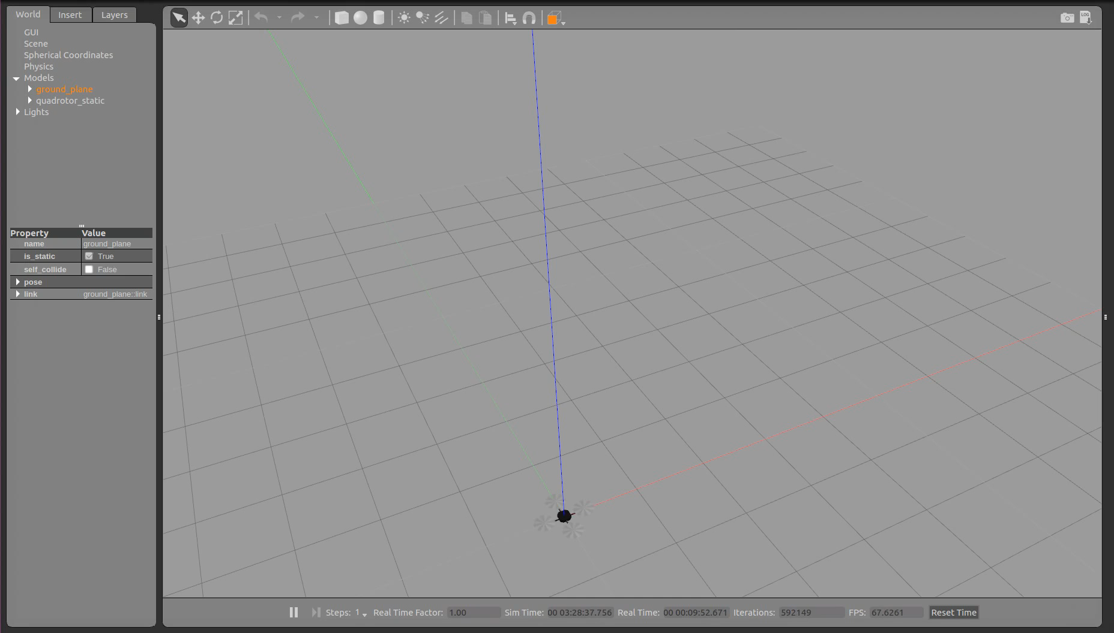
Results – Baseline Controller

Slide 16

Results – Adaptive Controller

Slide 17
Adaptive Control of a Quadrotor UAV
Aleix Paris i Bordas
MIT AeroAstro

